Slide 1

Legal, Ethical and Regulatory Constraints

Slide 2

Copyright Notice
The following material has been communicated to you by or on behalf of CCT College Dublin in accordance with the Copyright and Related Rights Act 2000 (the Act).
The material may be subject to copyright under the Act and any further reproduction, communication or distribution of this material must be in accordance with the Act.
Do not remove this notice

Slide 3
Data Licensing
Data Ownership and Use
Confidentially of the Data.
GDPR
Use of the data
  Commercial
  Academic
  Research
  Personal Use

Slide 4
Introduction to GDPR
What is GDPR?
Why was GDPR introduced?
Key principles of GDPR (lawfulness, fairness, transparency, purpose limitation, data minimisation, etc.).

Slide 5
Scope of GDPR
Who does GDPR apply to?
What types of data are protected under GDPR?
Territorial scope and extraterritoriality

Slide 6
Rights of Data Subjects
Right to access
1
Right to rectification
2
Right to erasure (the “right to be forgotten”)
3
Right to data portability
4
Right to object
5
Right to restrict processing
6

Slide 7
Data Controllers and Data Processors
Definitions and responsibilities of data controllers and data processors?
Joint controllership and data processing agreements.

Slide 8
Lawful Processing of Personal Data
Consent under GDPR
Legitimate interests
Contractual necessity
Legal obligations
Vital interests
Public task
Consent management and withdrawal

Slide 9
Data Protection Impact Assessments (DPIAs)
When and how to conduct DPIAs
Mitigating risks through DPISAs
https://gdpr-info.eu/

Slide 10
Data Breach Notification
What constitutes a data breach?
The 72-hour notification rule
Responsibilities of data controllers and processors in the event of a breach.

Slide 11
Data Protection Officers (DPOs)
Who needs a DPO?
Roles and responsibilities of DPOs

Slide 12
Practical Implementation of GDPR
Steps to ensure GDPR compliance
Privacy by Design and Default
Data protections policies and documentation

Slide 13
GDPR in a Changing Landscape
GDPR in the context of emerging technologies (AI, IoT, etc.)
Future developments and challenges in data protection.

Slide 14
Data Use
Prohibits the vendor from using the customer's data, except as necessary to provide the services or perform its other contractual obligations
Specifies which, if any, uses of the customer's data are permitted
Requires that the vendor maintain the confidentiality and security of the customer's data
Requires the vendor to promise that it will not use or attempt to use customer data in any other manner or for any other purpose
https://legal.thomsonreuters.com/en/insights/articles/data-licensing-taking-into-account-data-ownership

Slide 15
Licensing in Writing
Get in writing
  Directly from website
  Directly from company
The scope of customer information the vendor may use
The permitted uses of that information
The licensee's promise not to make any other use of the information
https://legal.thomsonreuters.com/en/insights/articles/data-licensing-taking-into-account-data-ownership

Slide 16
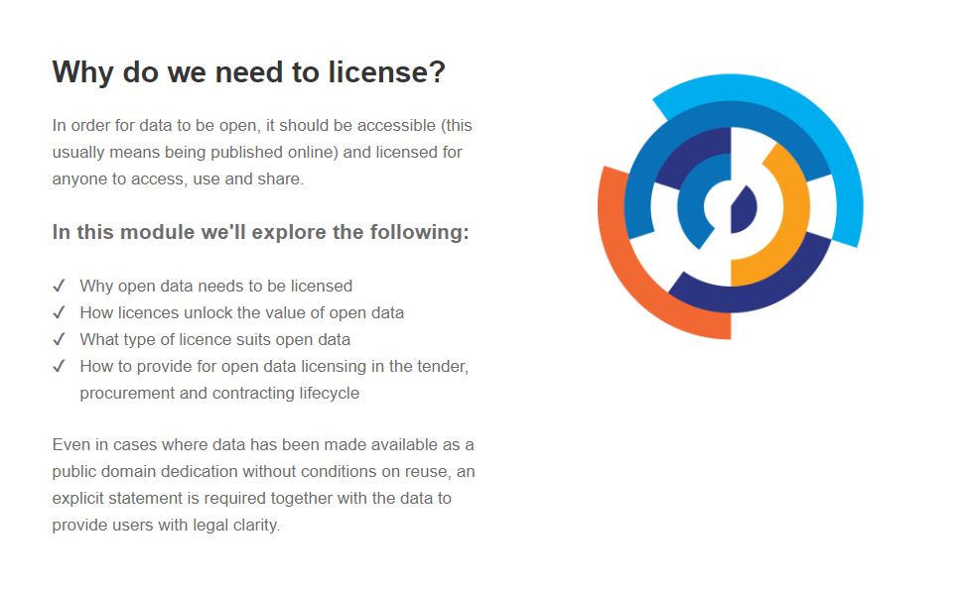
Data Licensing
https://data.gov.ie/edpelearning/en/module4/#/id/co-01

Slide 17
Data Ethics
“With the use of data comes the misuse of data. This has pretty much always
been the case, but recently this idea has been reified as “data ethics” and has
featured somewhat prominently in the news.
In the 2016 election, a company called Cambridge Analytica improperly accessed Facebook data and used that for political ad targeting.
In 2018, an autonomous car being tested by Uber struck and killed a pedestrian (there was a “safety driver” in the car, but apparently she was not paying attention at the time).
Algorithms are used to predict the risk that criminals will reoffend and to sentence them accordingly. Is this more or less fair than allowing judges to determine the same?
Some airlines assign families separate seats, forcing them to pay extra to sit together. Should a data scientist have stepped in to prevent this? “
(Grus, pg. 460)
Notes:
“Data ethics” purports to provide answers to these questions, or at least a framework for wrestling with them. I’m not so arrogant as to tell you how to think about these things (and “these things” are changing quickly), so in
this chapter we’ll just take a quick tour of some of the most relevant issues and (hopefully) inspire you to think about them further. (Alas, I am not a good enough philosopher to do ethics from scratch.)

Slide 18
What is ethics?
“moral principles that control or influence a person’s behaviour” Oxford Dictionary
Something you should not do even though it is not against the law
Should we care about ethics?
You might have to answer to managers, stake holders or even regulators how you acquired your data, use the data, store the data and erase unnecessary client data if applicable.

Slide 19
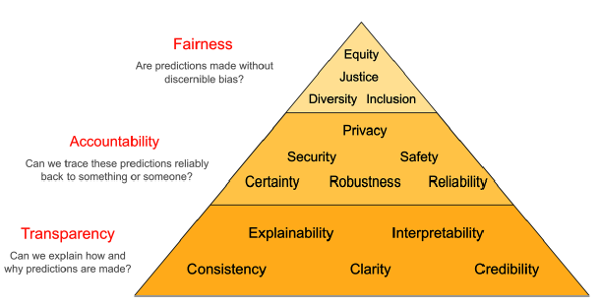
Ethics in AI
(Masís, 2021)

Slide 20
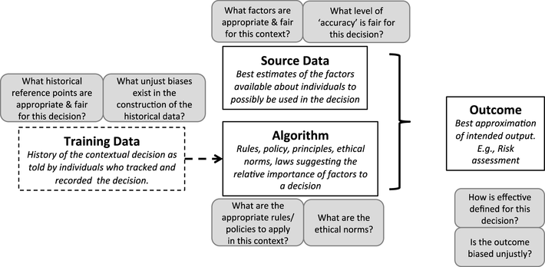
Ethics in AI
(Martin, 2018)

Slide 21
EU AI Act
AI Act: different rules for different risk levels
The new rules establish obligations for providers and users depending on the level of risk from artificial intelligence. While many AI systems pose minimal risk, they need to be assessed.
Unacceptable risk AI systems are systems considered a threat to people and will be banned. They include:
Cognitive behavioural manipulation of people or specific vulnerable groups: for example voice-activated toys that encourage dangerous behaviour in children
Social scoring: classifying people based on behaviour, socio-economic status or personal characteristics
Biometric identification and categorisation of people
Real-time and remote biometric identification systems, such as facial recognition
https://www.europarl.europa.eu/topics/en/article/20230601STO93804/eu-ai-act-first-regulation-on-artificial-intelligence

Slide 22
EU AI Act - High risk
AI systems that negatively affect safety or fundamental rights will be considered high risk and will be divided into two categories:
AI systems that are used in products falling under the EU’s product safety legislation. This includes toys, aviation, cars, medical devices and lifts.
AI systems falling into specific areas that will have to be registered in an EU database:
  Management and operation of critical infrastructure
  Education and vocational training
  Employment, worker management and access to self-employment
  Access to and enjoyment of essential private services and public services and benefits
  Law enforcement
  Migration, asylum and border control management
  Assistance in legal interpretation and application of the law.
All high-risk AI systems will be assessed before being put on the market and also throughout their lifecycle.
https://www.europarl.europa.eu/topics/en/article/20230601STO93804/eu-ai-act-first-regulation-on-artificial-intelligence

Slide 23
EU AI Act – General Purpose and Generative AI
Generative AI, like ChatGPT, would have to comply with transparency requirements:
Disclosing that the content was generated by AI
Designing the model to prevent it from generating illegal content
Publishing summaries of copyrighted data used for training
High-impact general-purpose AI models that might pose systemic risk, such as the more advanced AI model GPT-4, would have to undergo thorough evaluations, and any serious incidents would have to be reported to the European Commission.
https://www.europarl.europa.eu/topics/en/article/20230601STO93804/eu-ai-act-first-regulation-on-artificial-intelligence

Slide 24
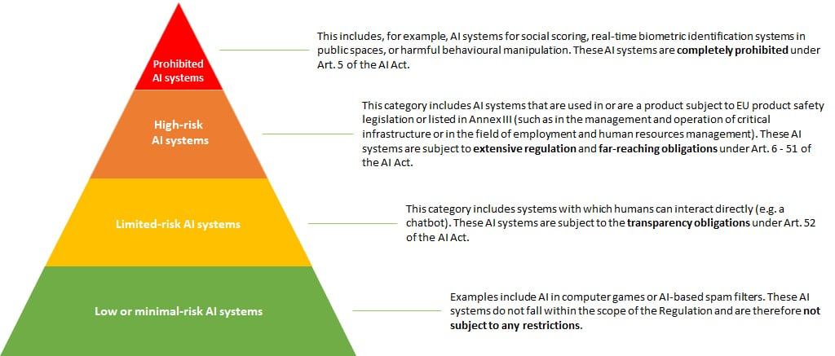
EU AI Act
https://www2.deloitte.com/dl/en/pages/legal/articles/ki-verordnung-eu.html

